Slide 1

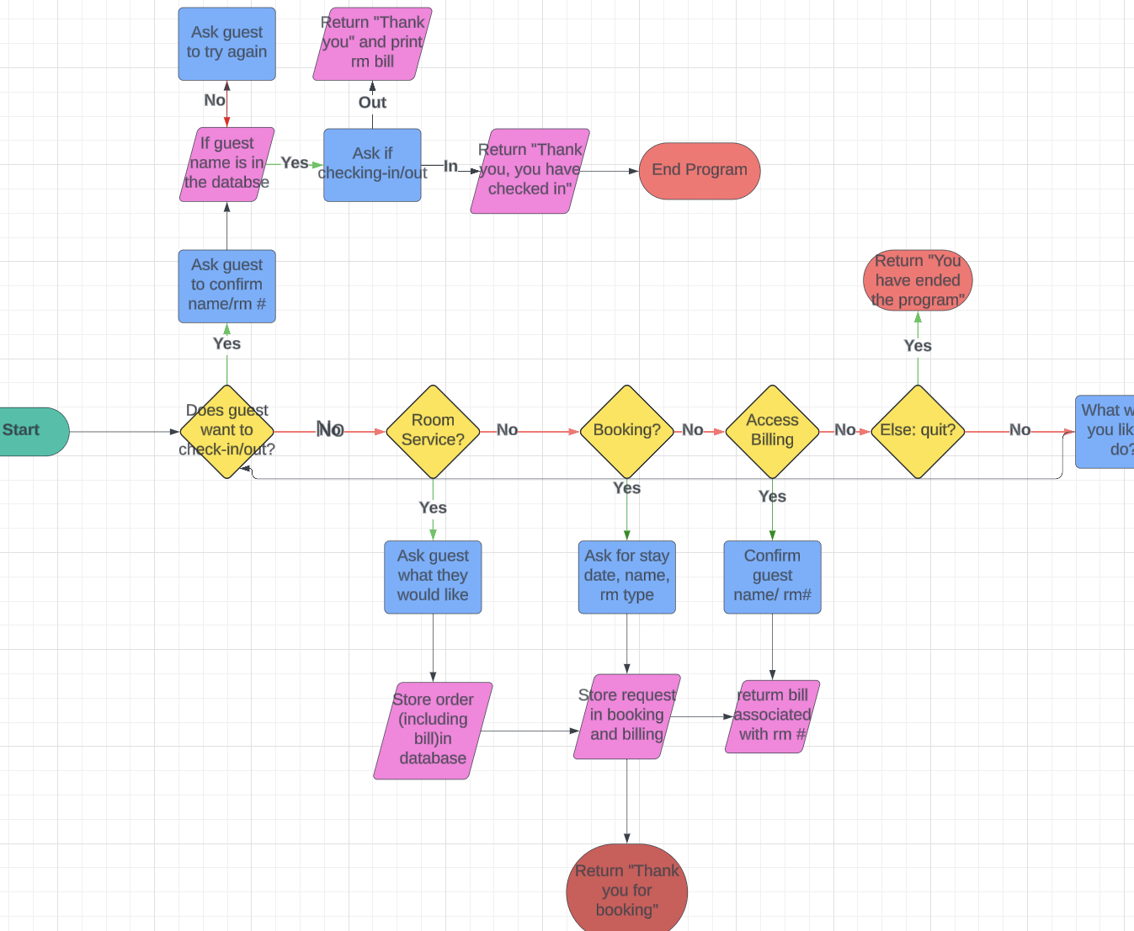
Hotel Management Tracker By: Destiny Hopson
This system allows hotel guests to access their hotel needs without the hassle of going to the front desk for help. This system has options for guests to: Check-in/out, Access Billing, Room Service, and Booking. The system allows guests to make choices as to which type of room they would like to book, what would they like to order form the menu, which date they would like to book from, and more. This code also contains a limited amount of room numbers and will not allow guests to book a certain type of room if there are no more rooms available. In essence, this code is to ease the access for guests while they enjoy their stay and to reduce the workload for hotel staff.
*The photo to the right shows a visual representation of the code*

